Slide 1

Space Syntax Toolkit for QGIS Introduction and recent developments
Abhimanyu Acharya
Associate, Space Syntax Ltd.
Ioanna Kolovou
Senior consultant, Space Syntax Ltd.
Space Syntax Laboratory - UCL
Space Syntax Limited
Workshop 3
Space syntax and analytical design workshops
MSc, MRes Space Syntax: Architecture and Cities
UCL

Slide 2
Introduction
Who we are
Jorge Gil MSc, PhD
Researcher UCL, Chalmers, TU Delft
Open Source GIS consultant and developer
Author ‘Space Syntax Toolkit’ for QGIS (2013 - )
Author ‘Confeego’ for MapInfo (2004 - 09)
Stephen Law MSc
Researcher, Turing Institute, UCL
Associate, Space Syntax Limited
Ioanna Kolovou MRes
Senior Consultant, Space Syntax Limited
Abhimanyu Acharya MSc
Associate, Space Syntax Limited

Slide 3
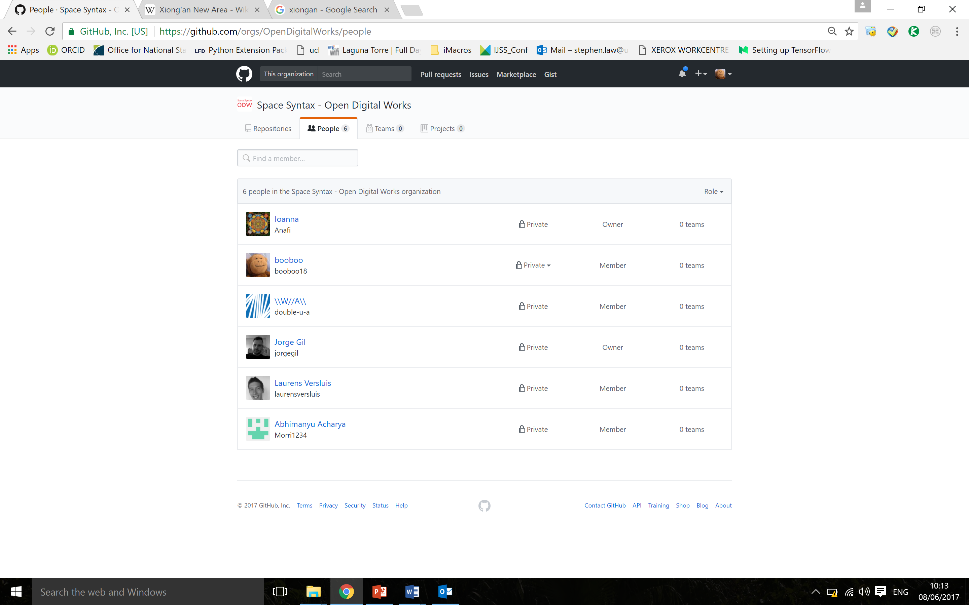
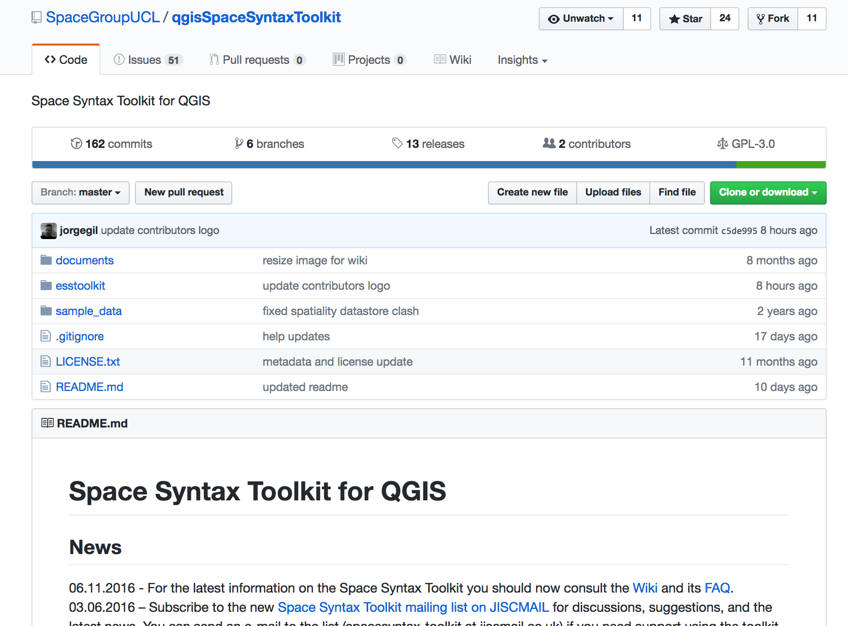
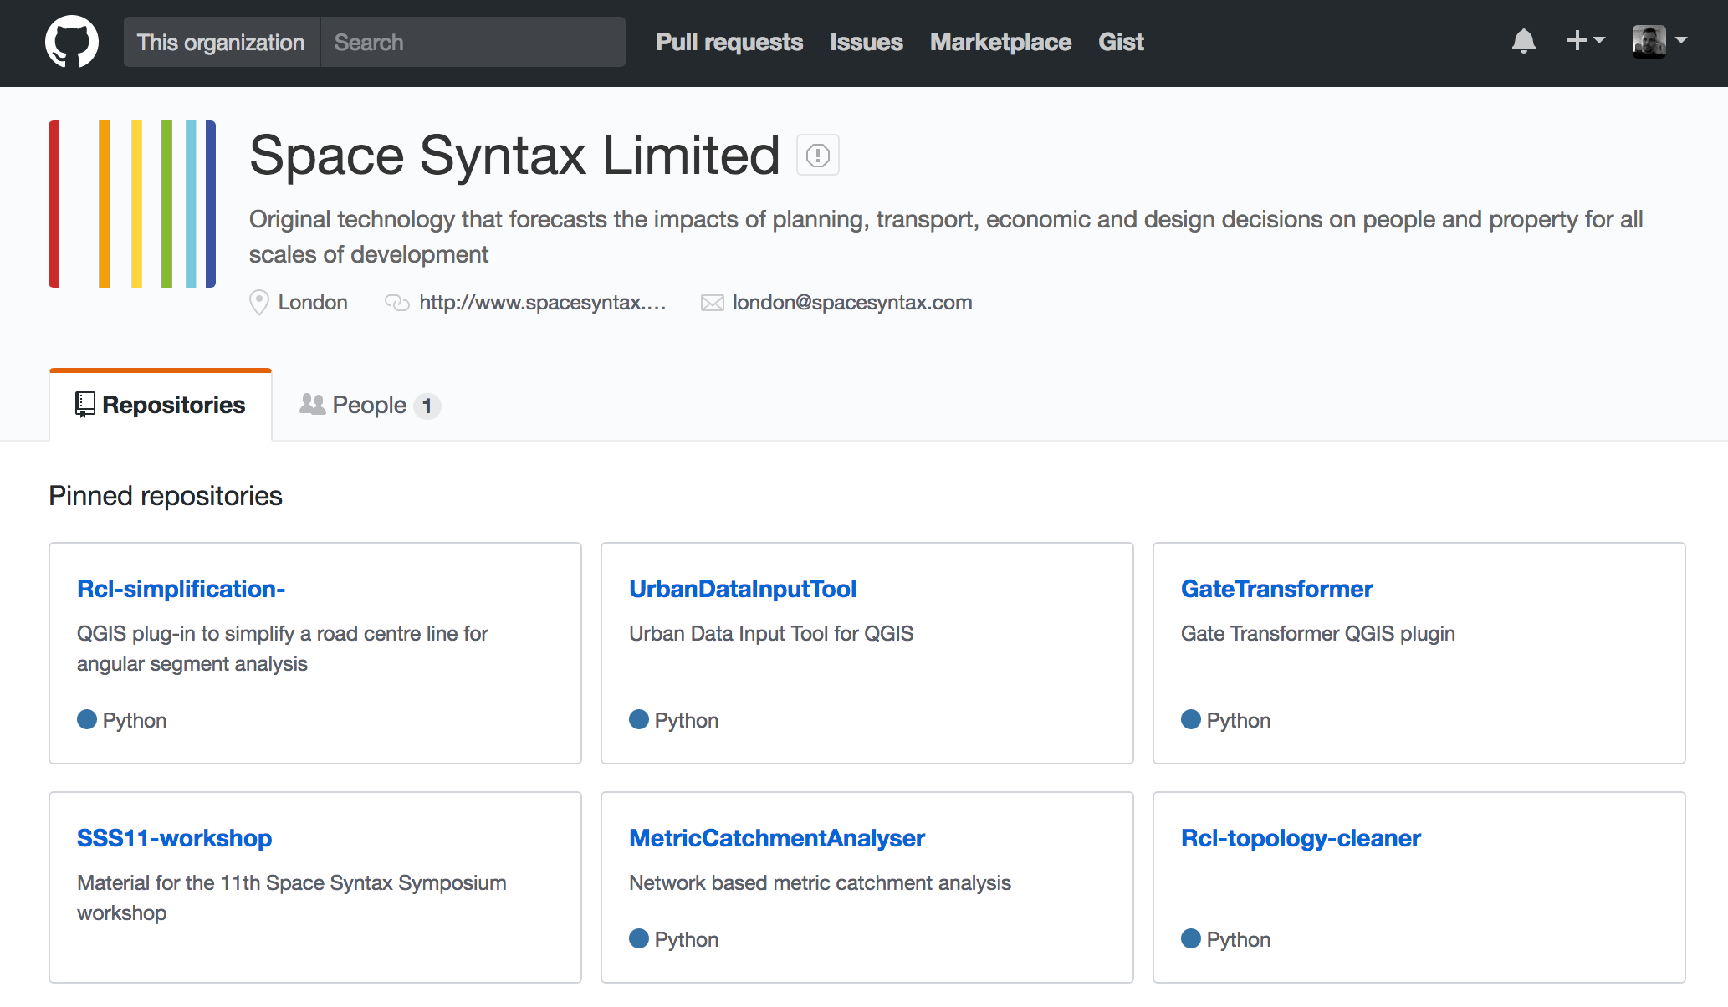
Introduction

Slide 4
Introduction
Objectives
Learn how to use the 'Space Syntax Toolkit' (SST) for standard Space syntax axial and segment analysis in QGIS
Learn about data input methods

Slide 5
Introduction
Requirements
Participants must bring their own laptops in order to carry out the exercises, with the necessary software pre-installed:
QGIS 2.14 LTR (or higher):
http://qgis.org/en/site/forusers/download.html
depthmapXnet 0.35:
http://archtech.gr/varoudis/depthmapX/?dir=depthmapXnet
Space Syntax Toolkit:
https://github.com/SpaceGroupUCL/qgisSpaceSyntaxToolkit/wiki/Installation

Slide 6
Introduction
Programme
Introduction to SSXToolkit
Task 1a - Model preparation & verification
Task 1b – Model processing & visualisation
Task 2 – Data input

Slide 7
Overview
Space syntax theory and the SST project
Overview of relevant space syntax concepts
Overview of the SST project
SST installation in QGIS and downloading the sample data set

Slide 8
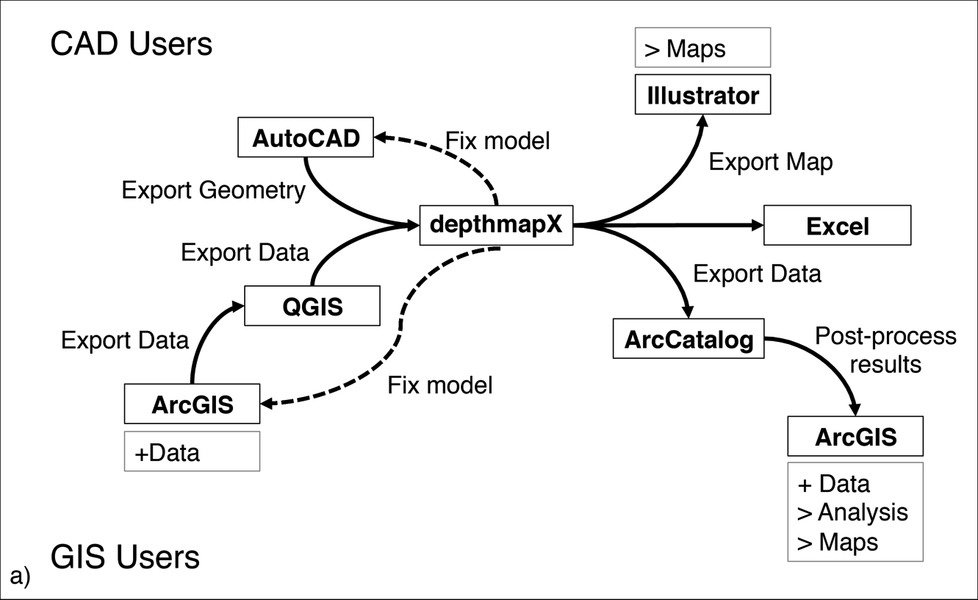
The SST Project

Slide 9
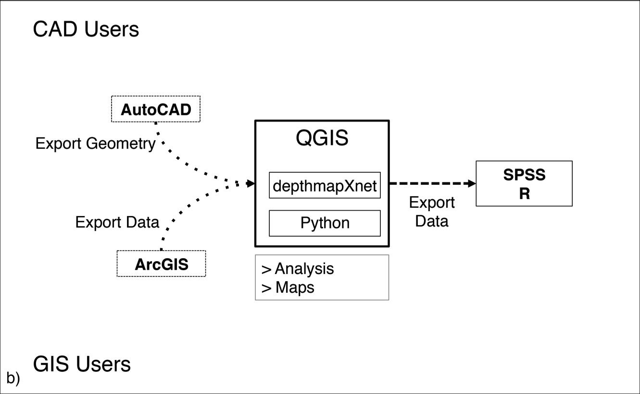
The SST Project

Slide 10
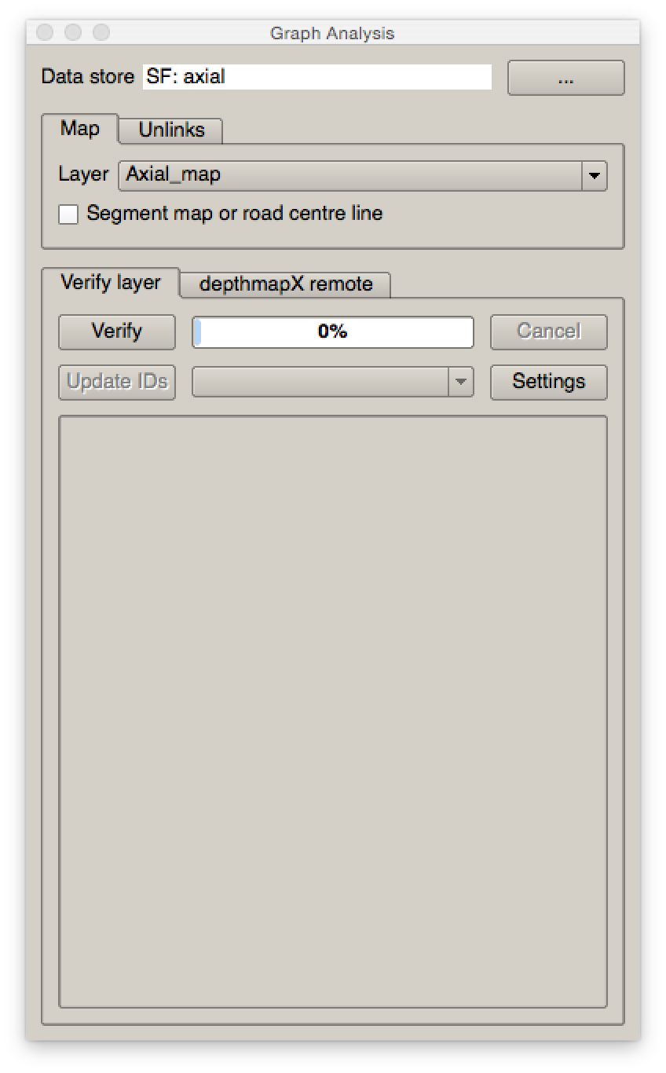
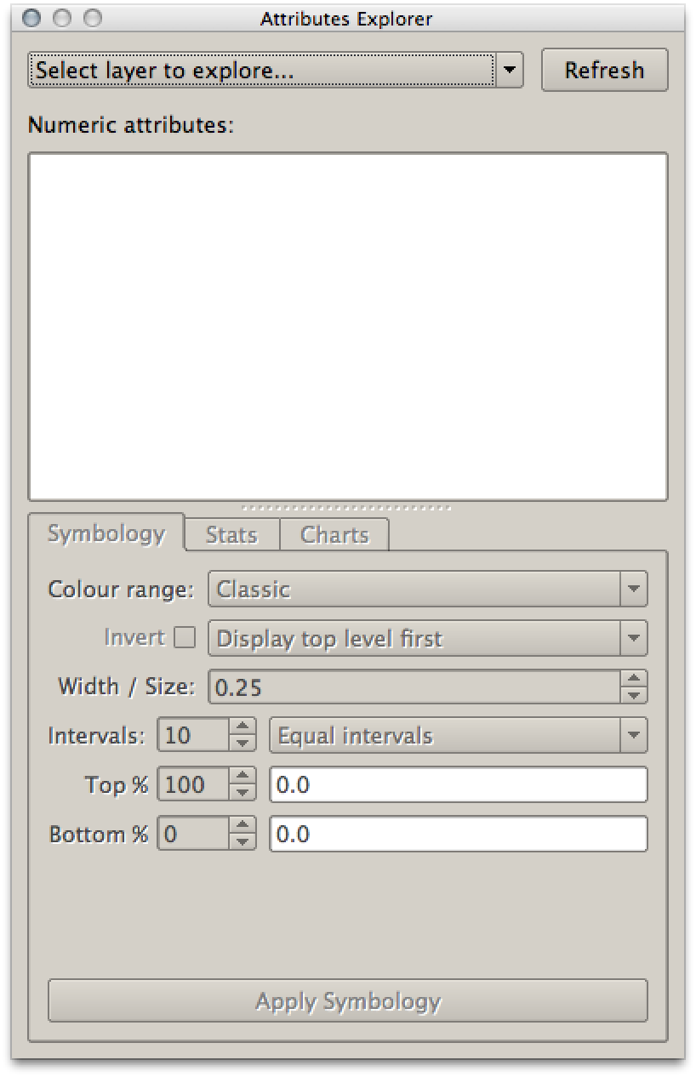
Original tools: SST version 0.1.x
Graph Analysis
Attribute Explorer

Slide 11
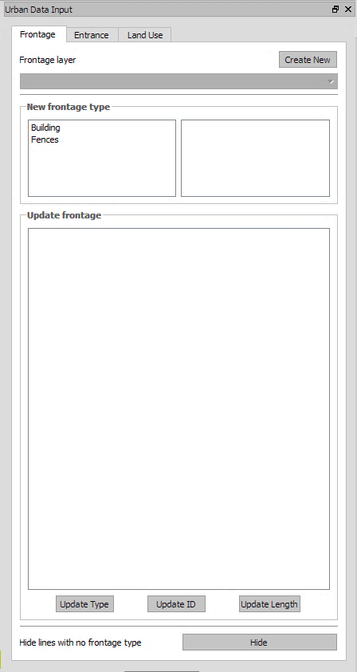
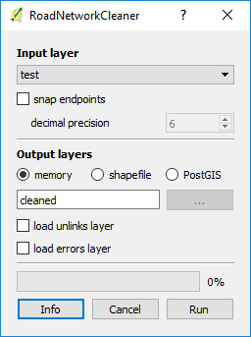
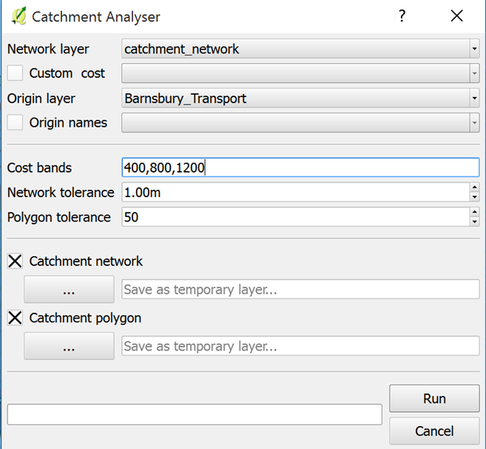
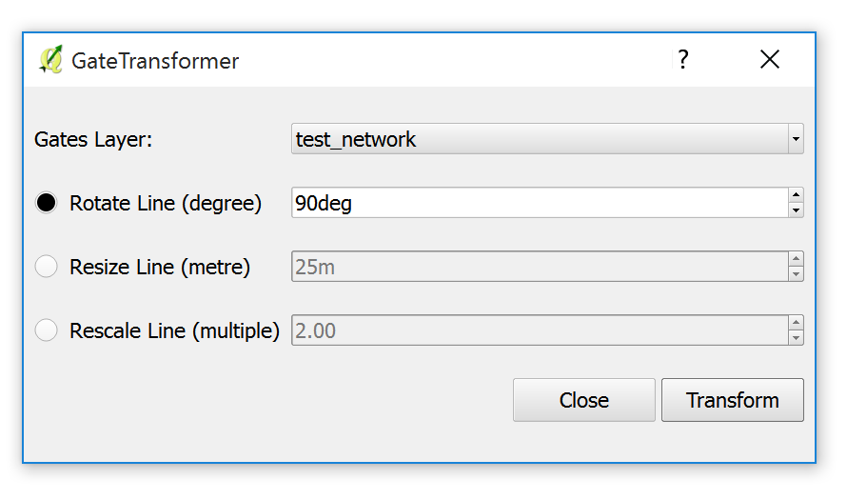
New Set of tools: SST version 0.2.0
Road network cleaner
Urban Data Input Tool
Catchment Analyser
Gate Transformer

Slide 12
Demo Workflow
Axial Map Verification
RCL Topology Cleaning
Unlinks Verification
Processing algorithm: simplify geometries
Space Syntax Analysis
Catchment Analyser
Visualisation
Urban data input
Gate Transformer/movement correlation
Integrated Urban Model

Slide 13
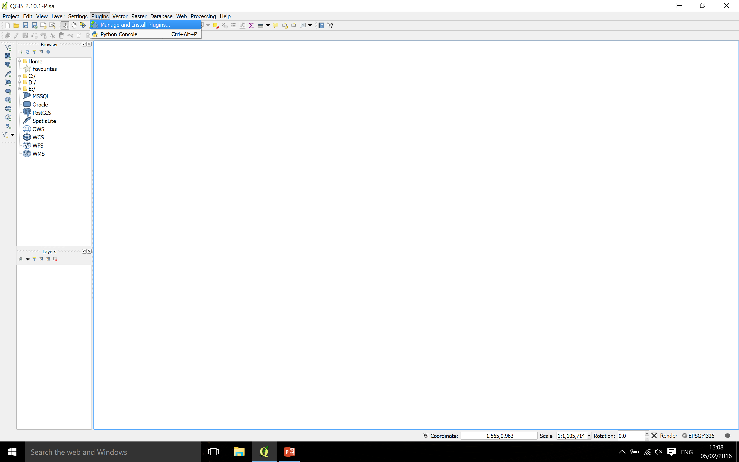
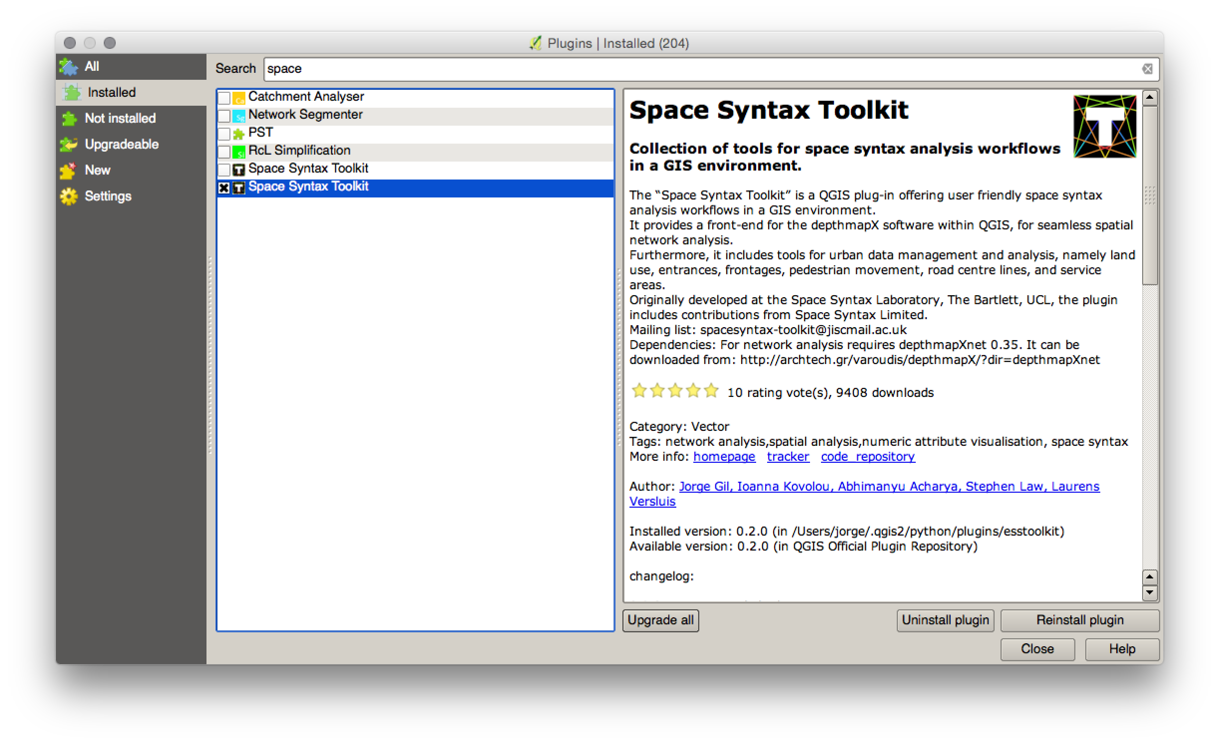
SST Installation

Slide 14
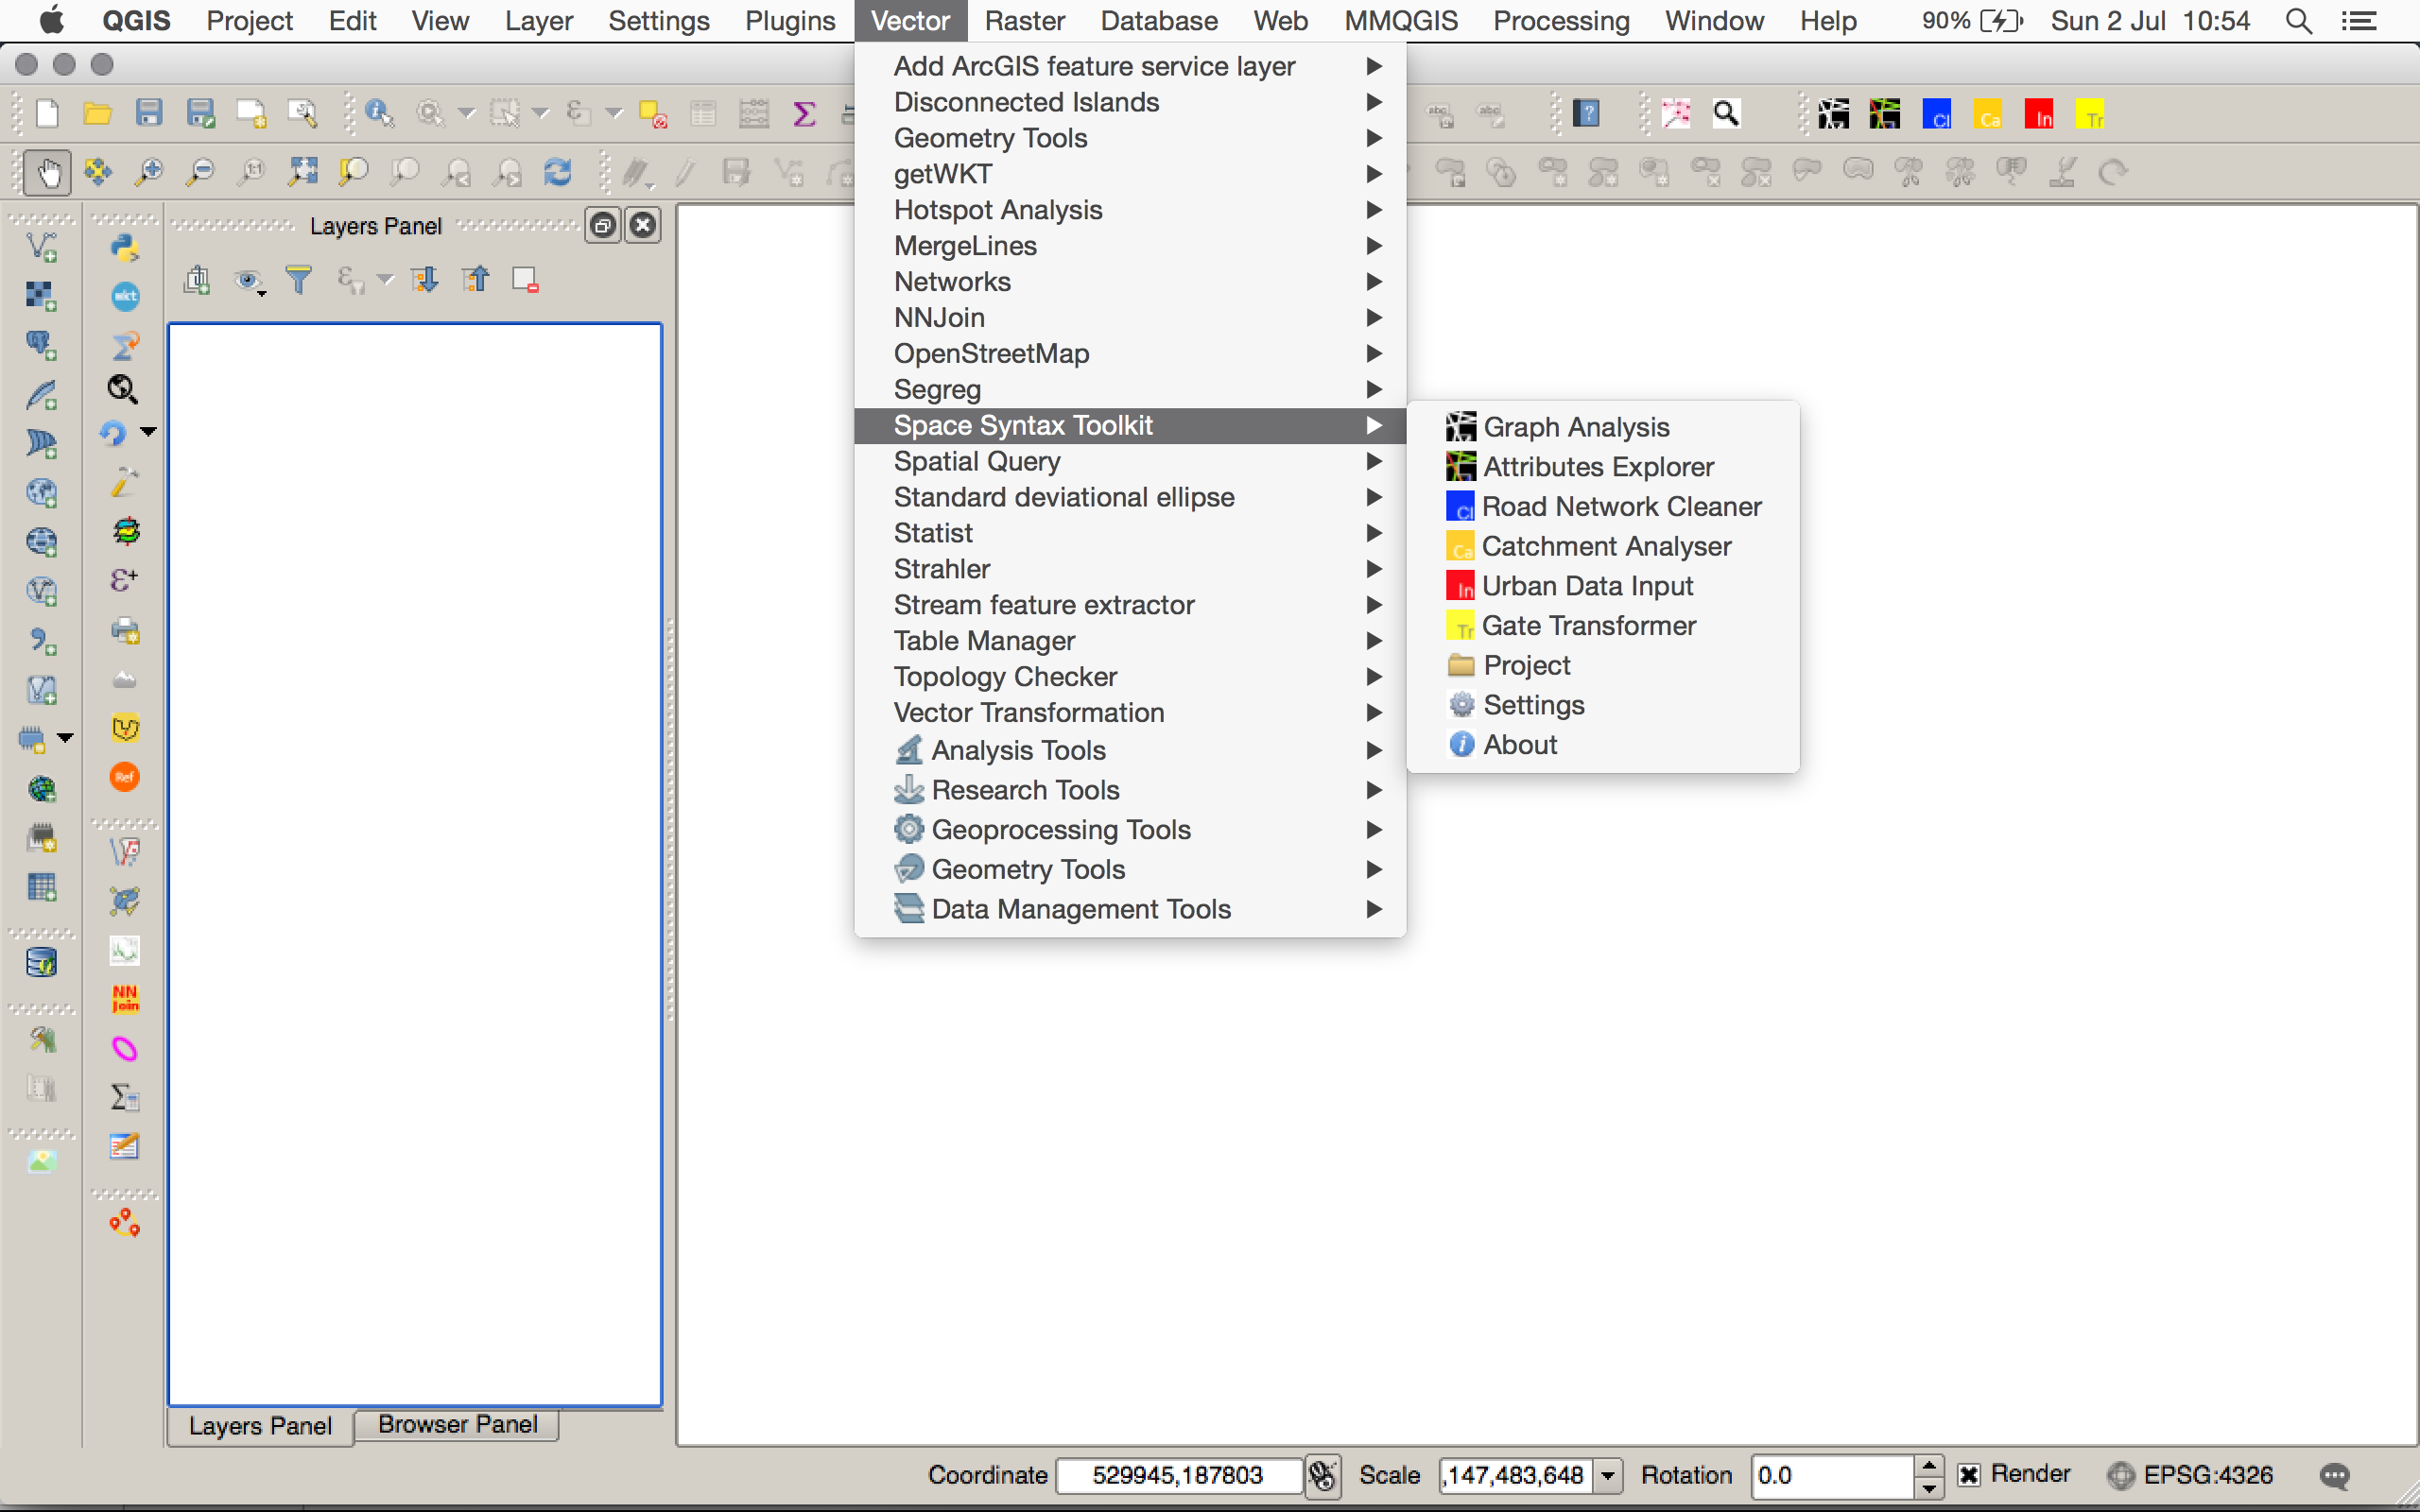
SST Installation

Slide 15
Task 1
Preparing and analysing axial models
Model preparation: making axial and unlinks maps
Model verification: verifying the axial and unlinks maps
Model analysis: Axial and segment analysis of the axial model
Visualising the results

Slide 16
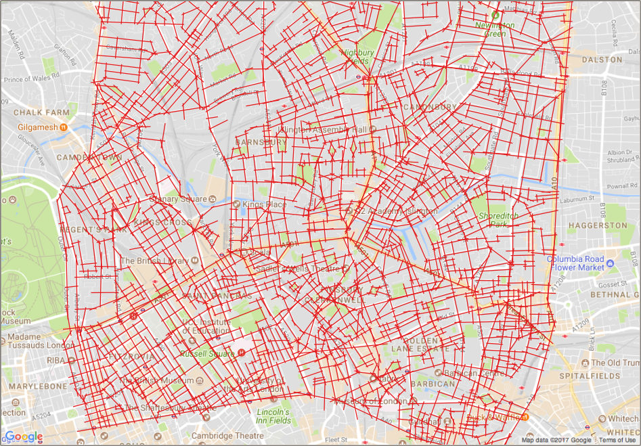
Model preparation: making axial and unlinks maps
Drawing an axial map (use a projected CRS!)

Slide 17
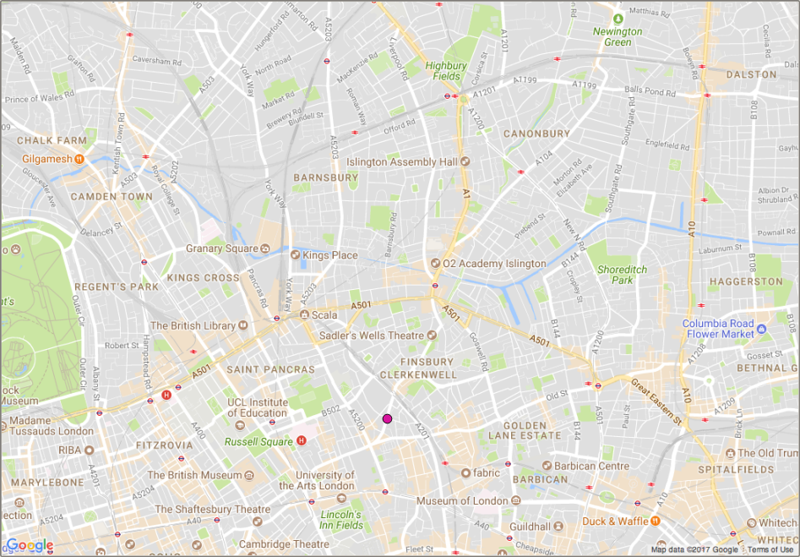
Model preparation: making axial and unlinks maps
Drawing an unlinks map

Slide 18
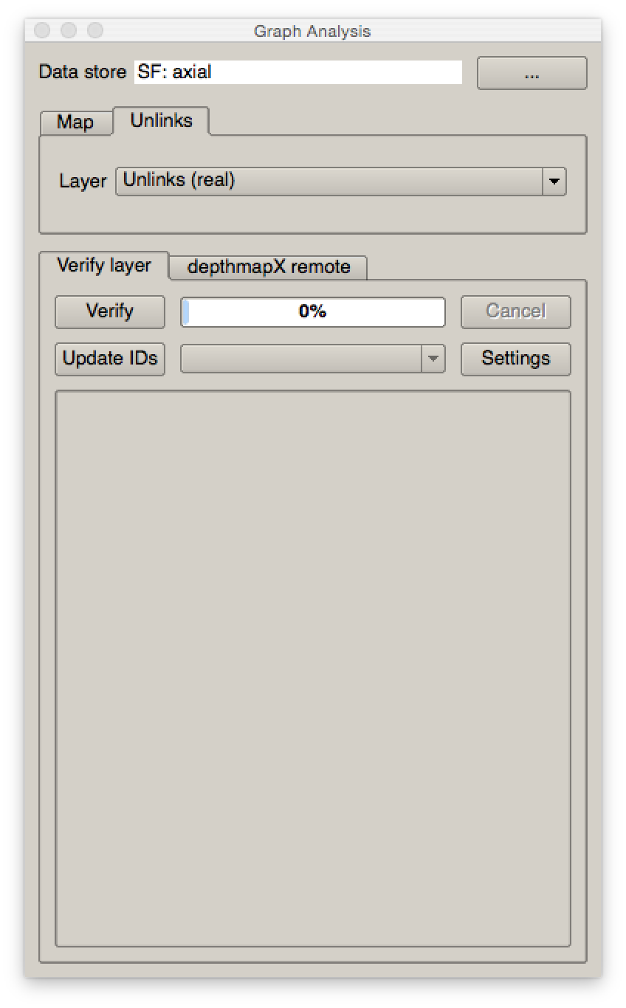
Model verification: verifying the axial and unlinks maps
Load the layers in the Graph Analysis Tool

Slide 19
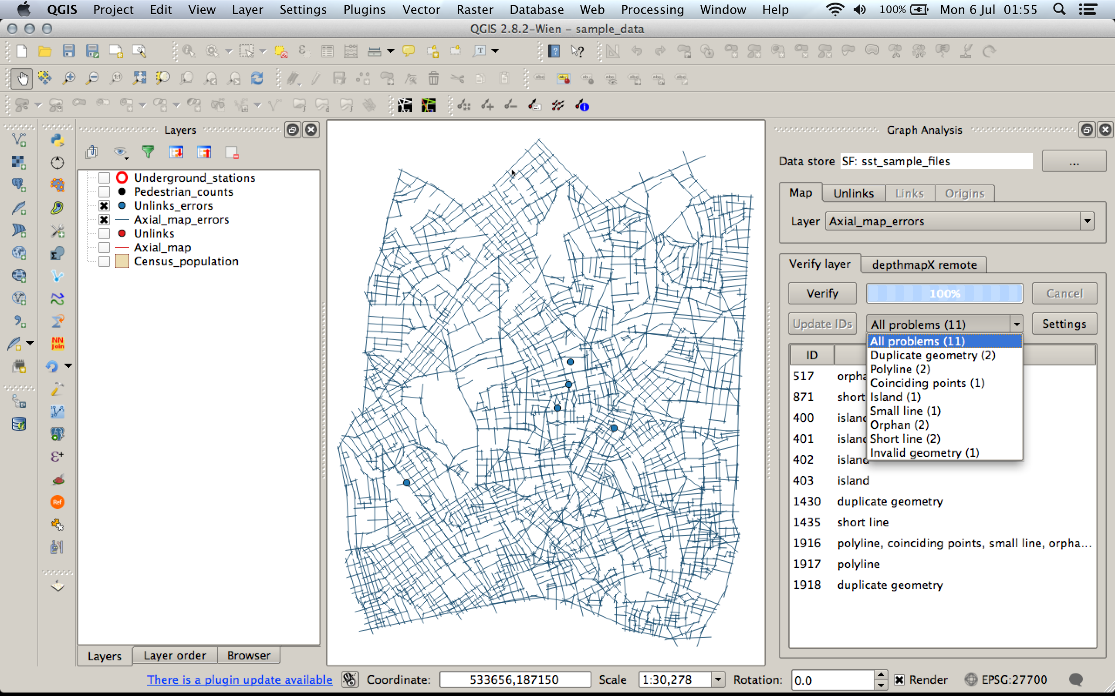
Model verification: verifying the axial and unlinks maps
Verification is done on the two layers combined

Slide 20
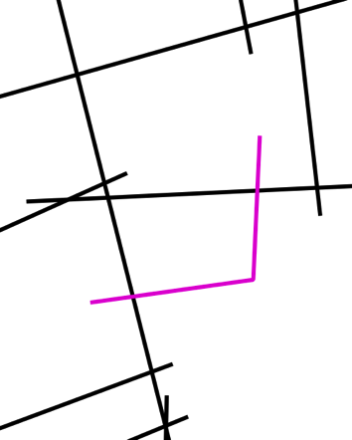



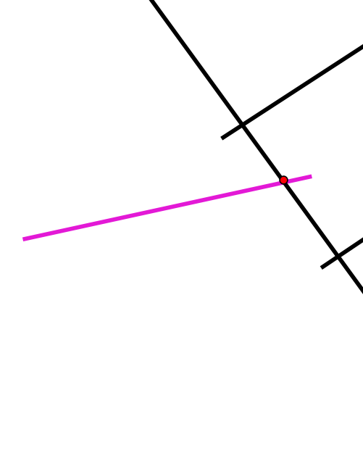

Model verification: verifying the axial and unlinks maps
Axial map errors
Polyline
Duplicate
Undershoot
(short line)
Orphan
Unlinked orphan
Island
Small
Coinciding points
a)
b)
c)
d)
e)
f)

Slide 21
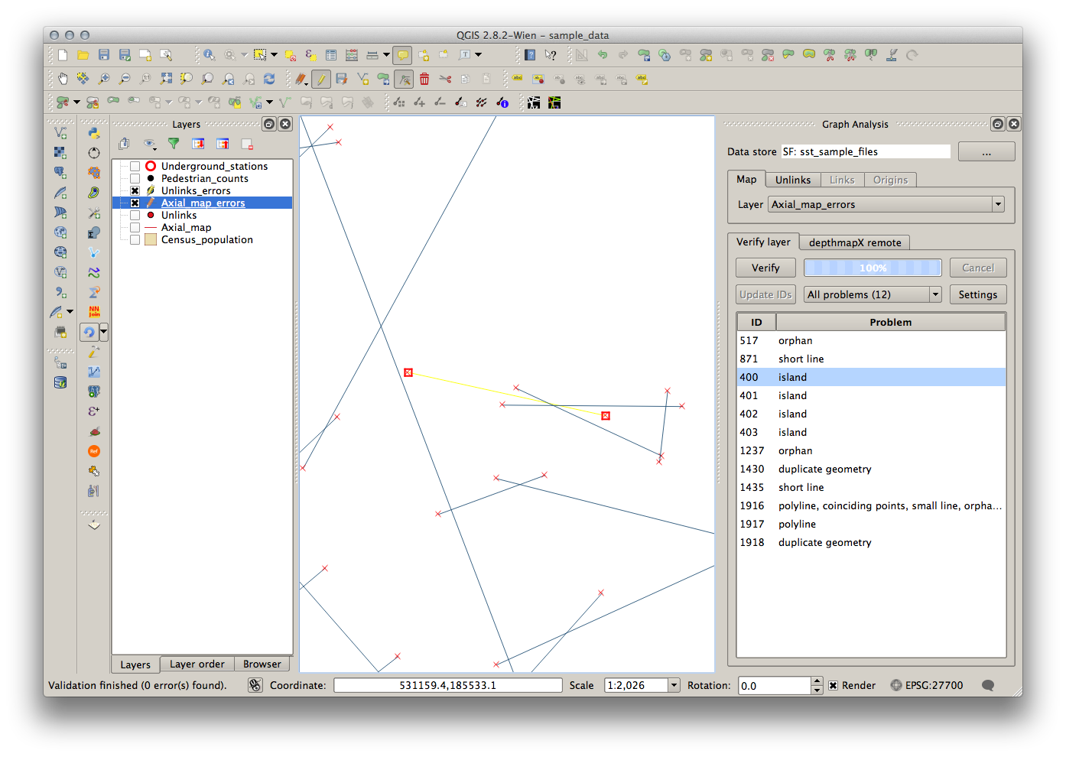
Model verification: verifying the axial and unlinks maps
Correcting the axial map

Slide 22

Model verification: verifying the axial and unlinks maps
Correcting the axial map

Slide 23
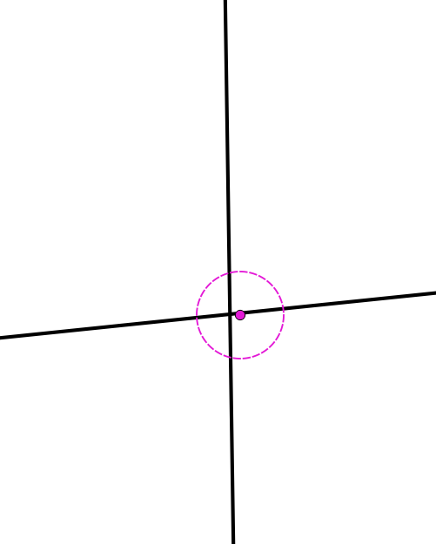
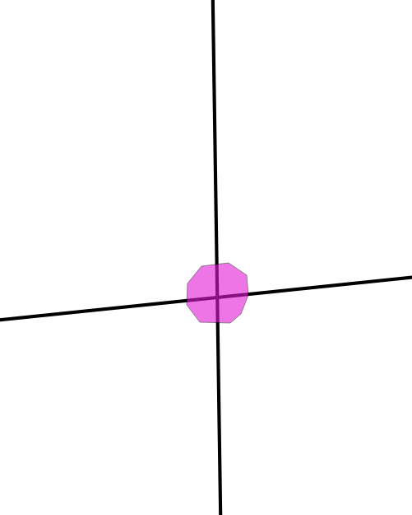

Model verification: verifying the axial and unlinks maps
Representing unlinks

Slide 24
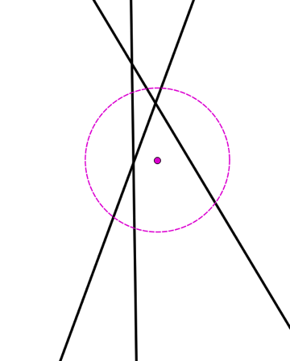
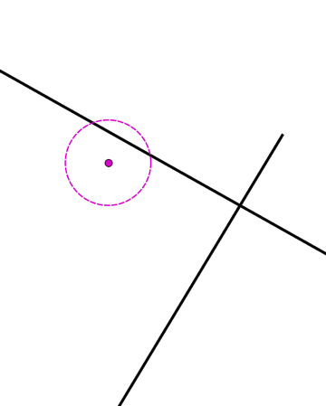
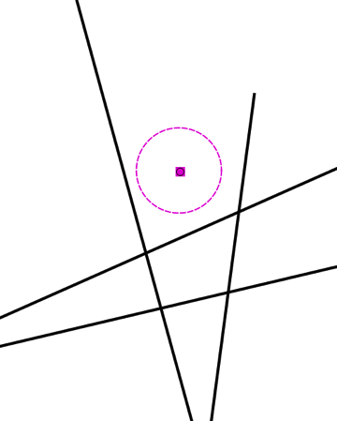
Model verification: verifying the axial and unlinks maps
Unlink errors
Feature errors:
More than 2 lines
Single line
No lines
Attribute error:
No line id
Same line id
Unmatched line id
3
1
2

Slide 25
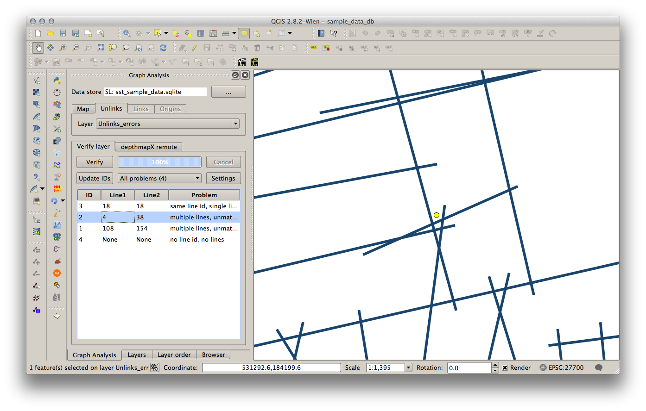
Model verification: verifying the axial and unlinks maps
Correcting the unlinks map

Slide 26
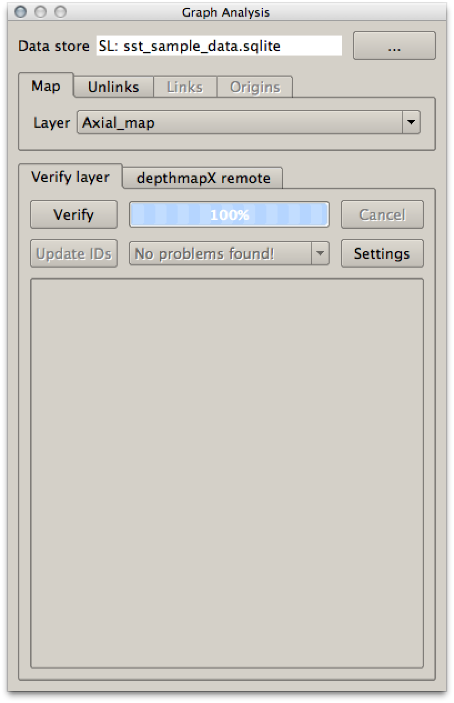
Model verification: verifying the axial and unlinks maps
Axial model verification workflow
It’s an iterative process that stops when the verification of axial map and unlinks returns no errors.
Verify and fix axial lines
Update unlinks ids
Verify and fix unlinks
Verify and fix axial lines
Verify and fix unlinks
Update unlink ids
Verify and fix axial lines
…

Slide 27
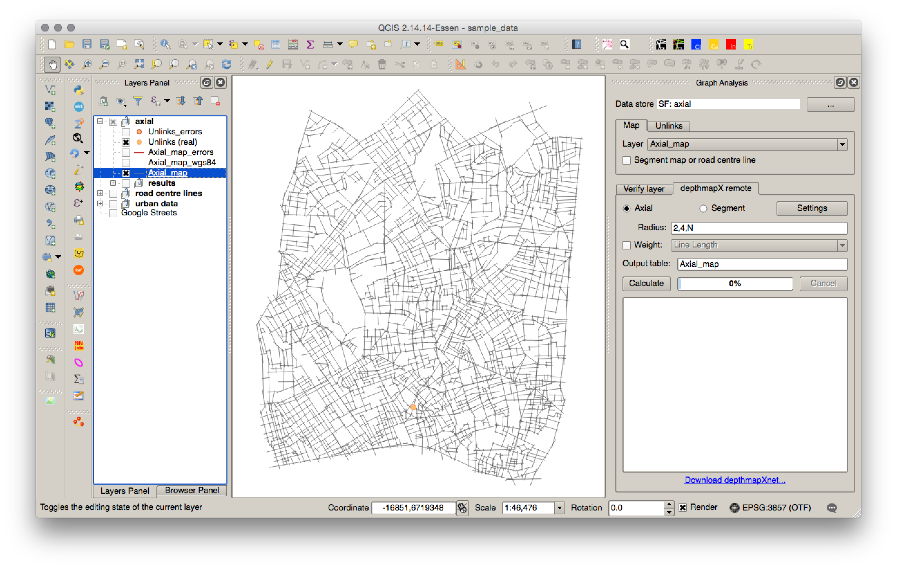
Model analysis: Axial analysis of the axial model
DepthmapX remote axial analysis settings

Slide 28

Model analysis: Segment analysis of the axial model
DepthmapX remote segment analysis settings

Slide 29
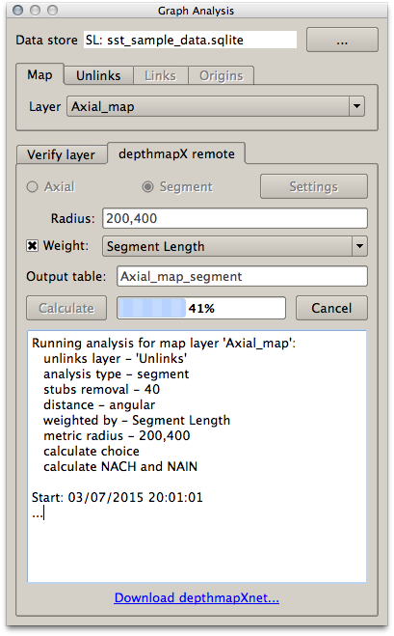
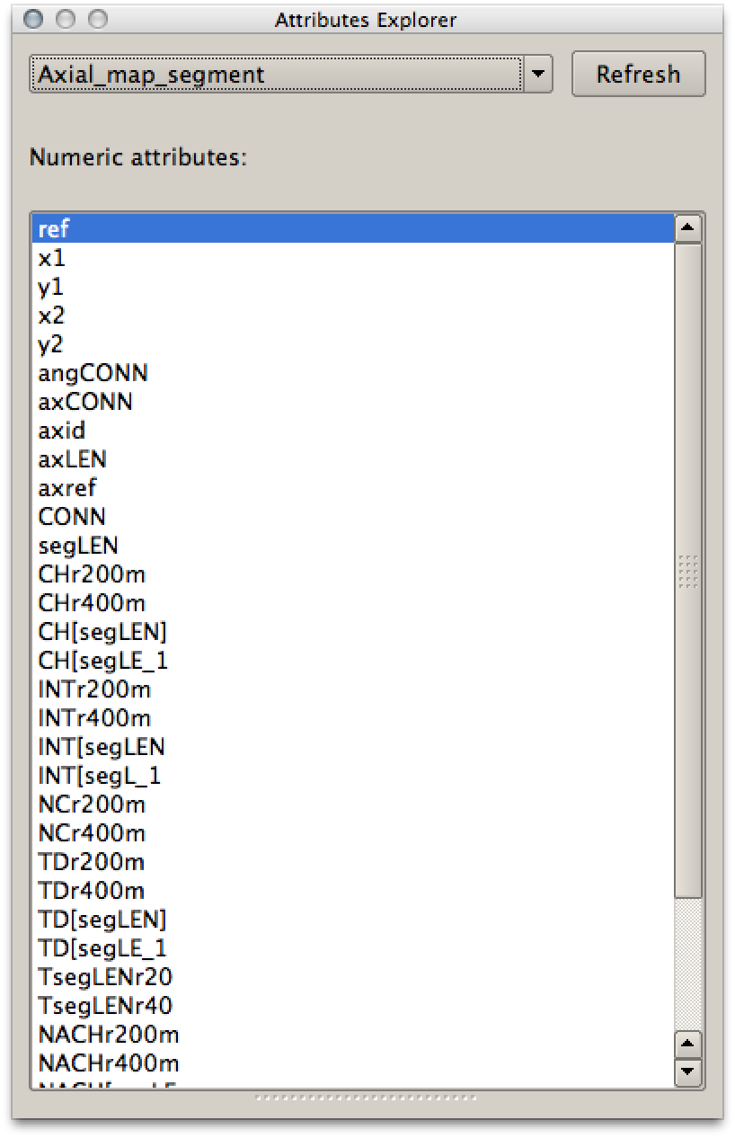
Model analysis
Results report and postprocessing the results

Slide 30
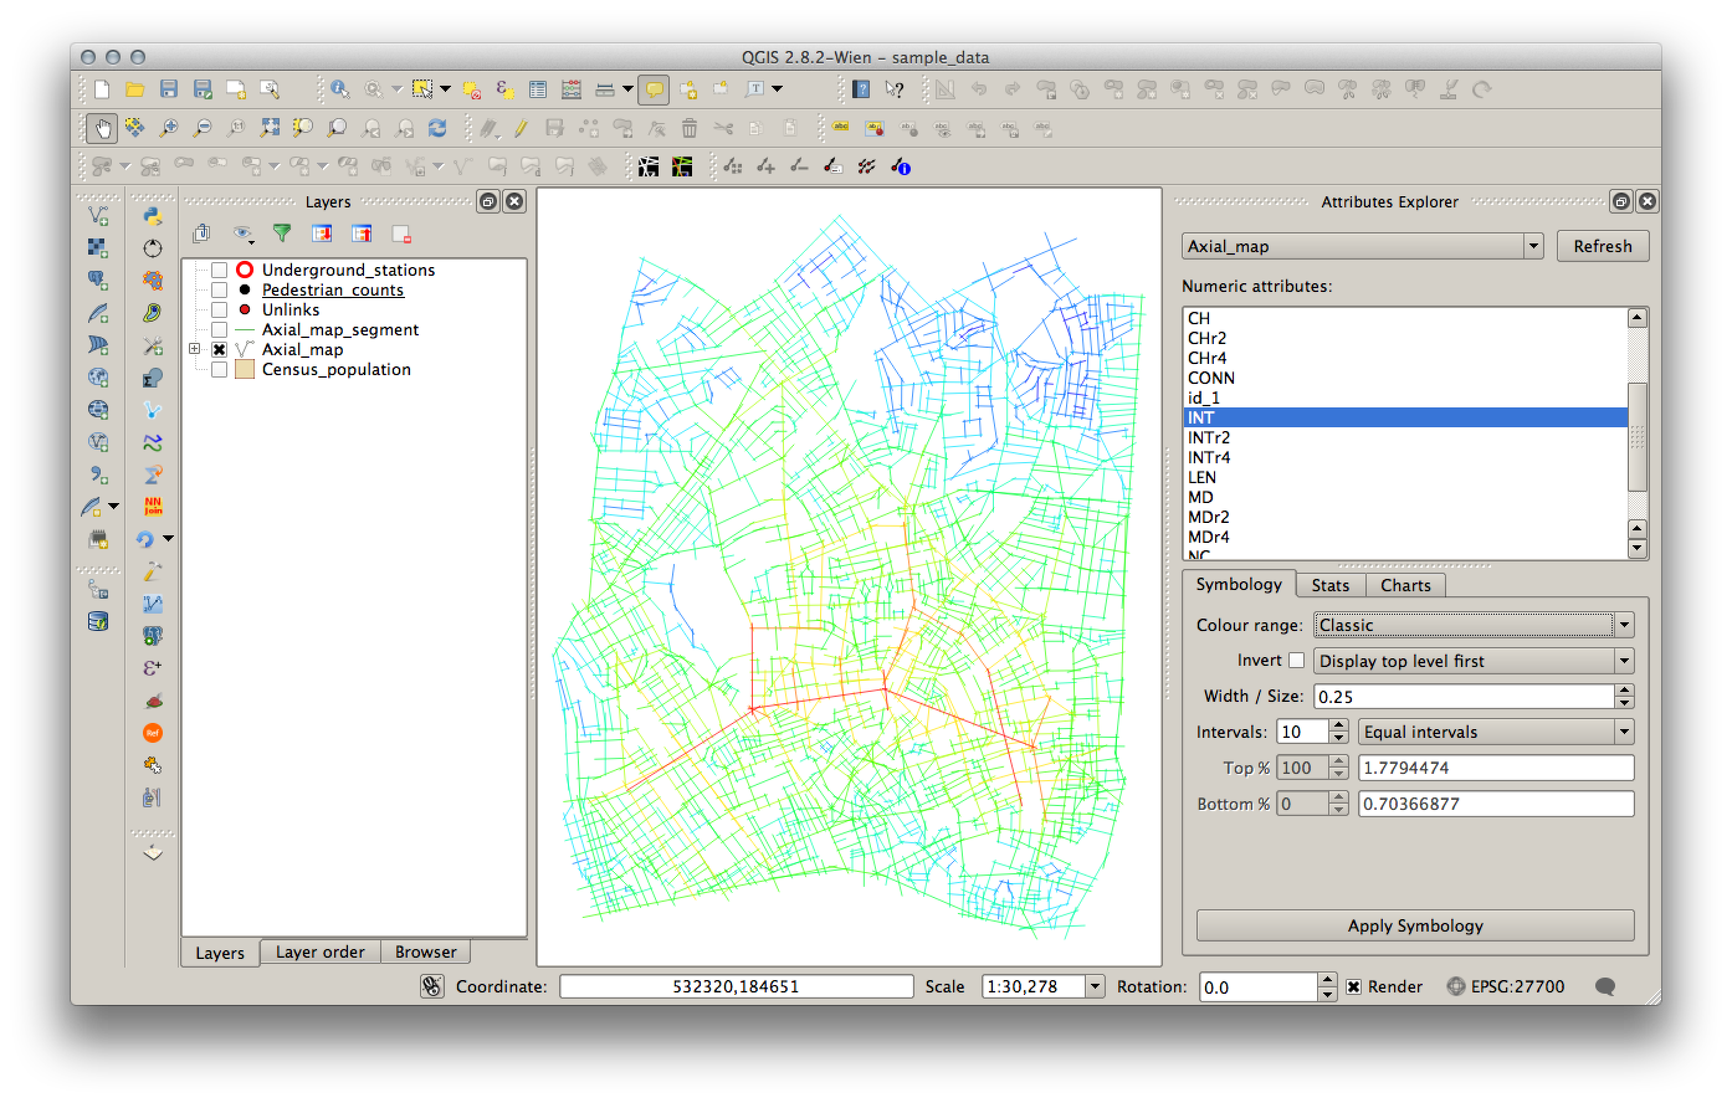
Visualising the results
Loading analysis results in Attributes Explorer Tool

Slide 31
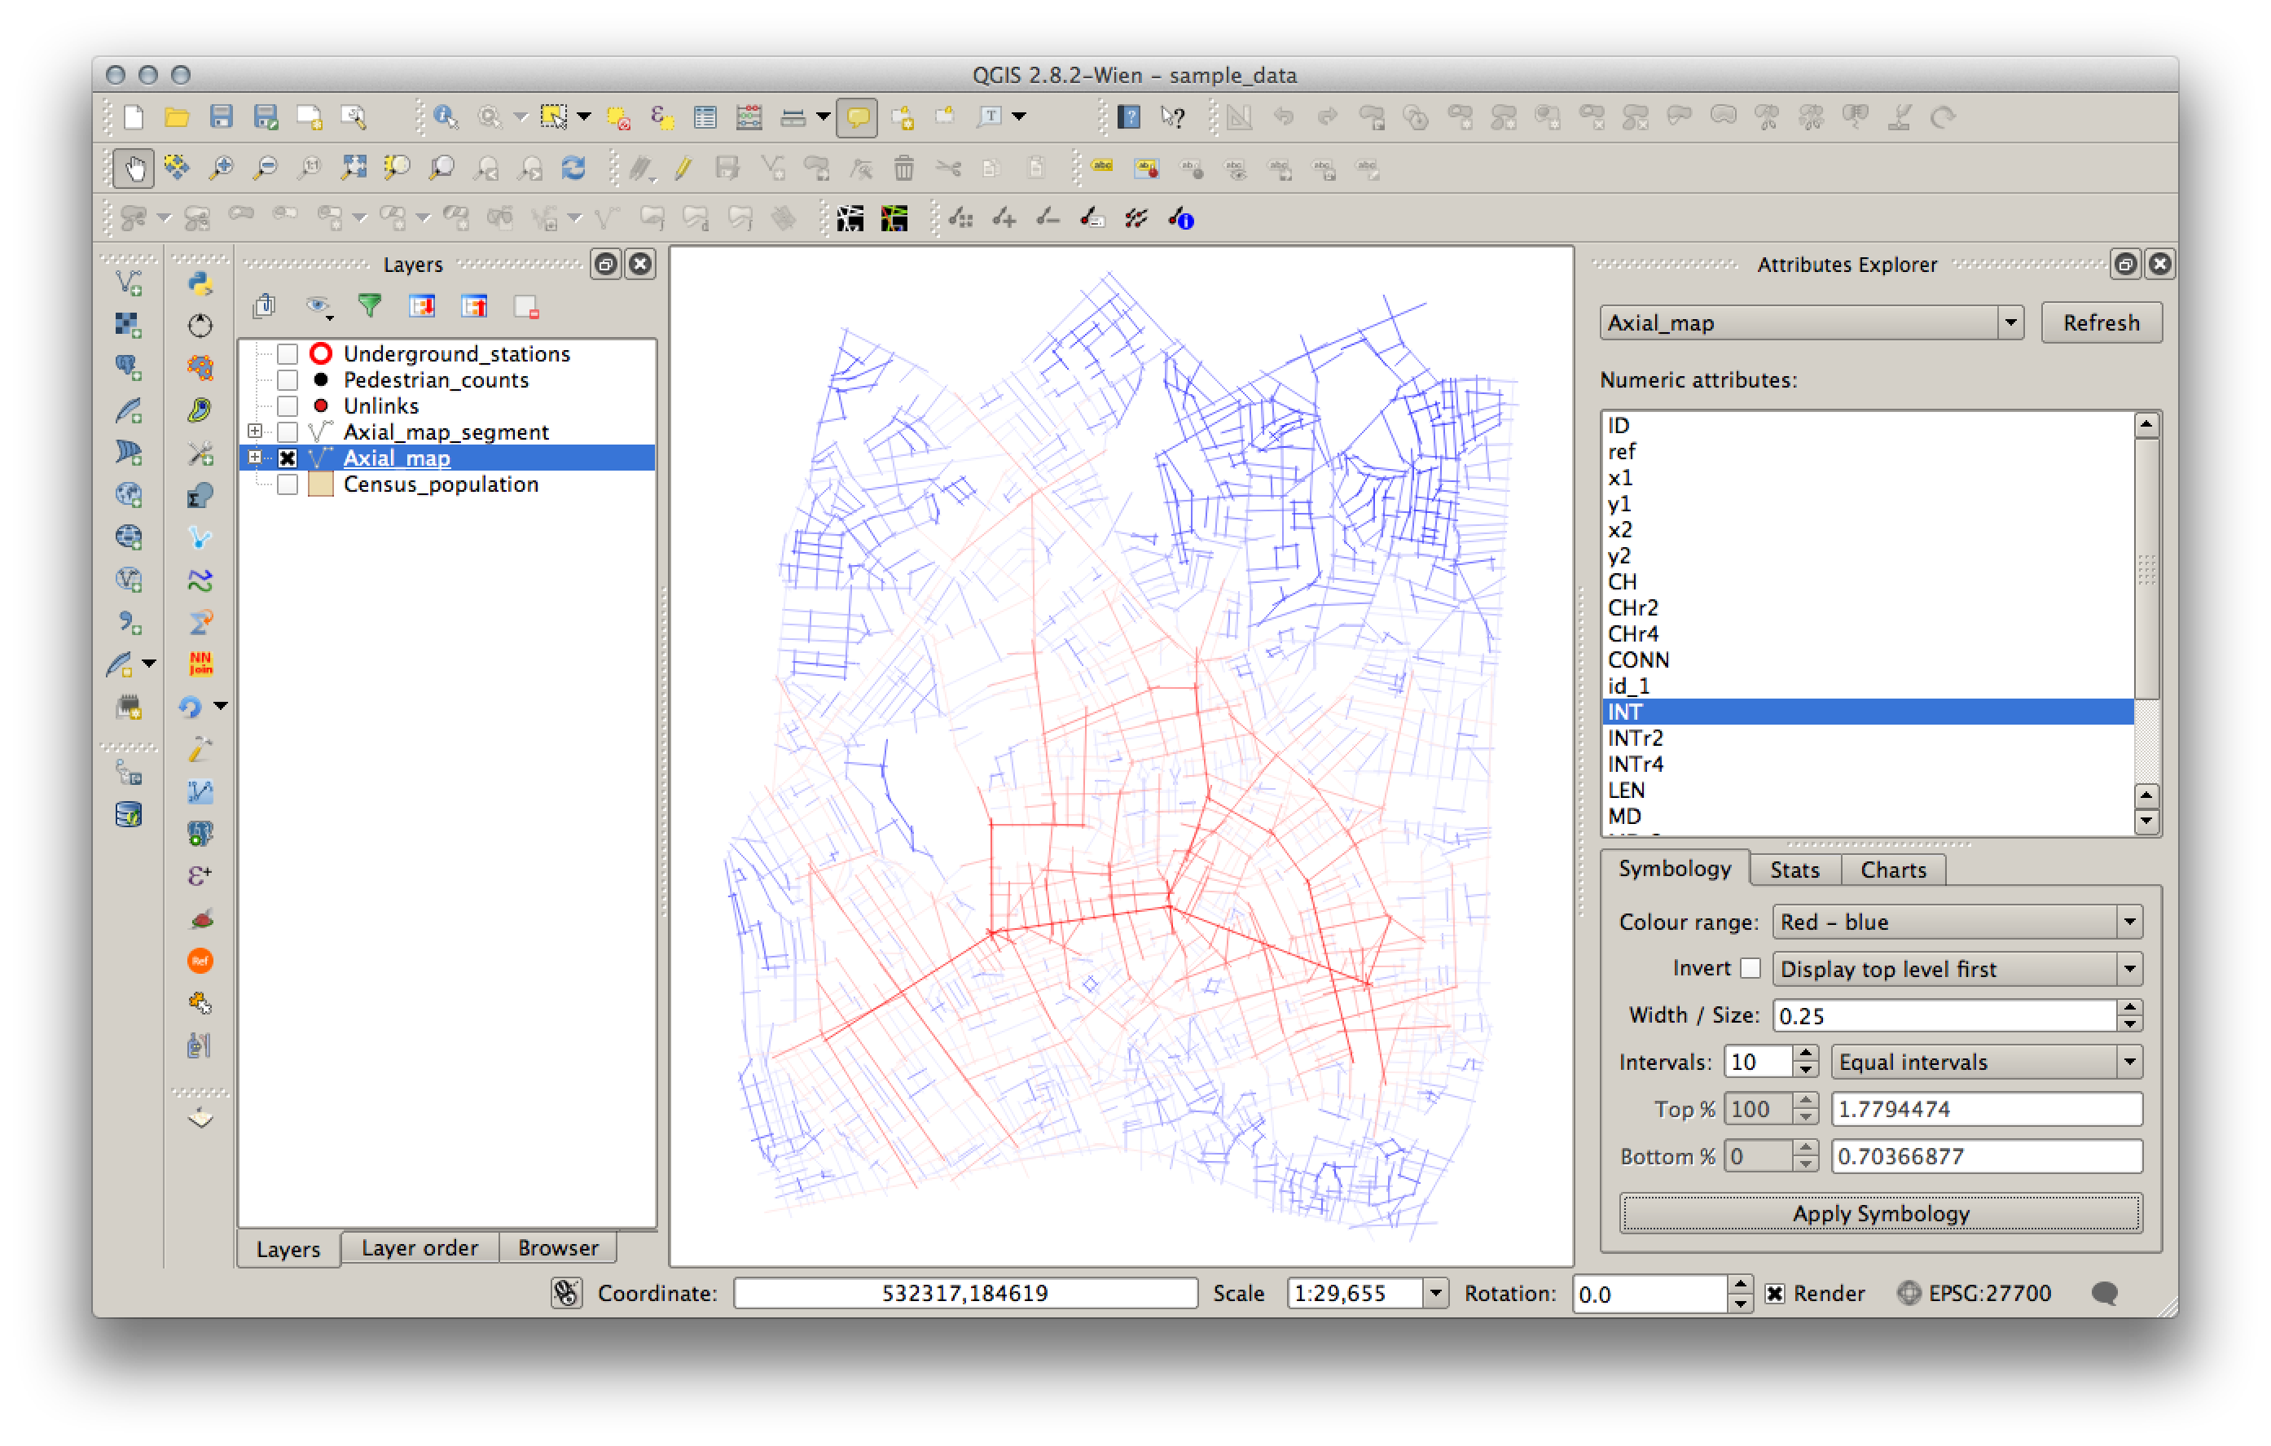
Visualisation and discussion of the results
Changing colour range

Slide 32
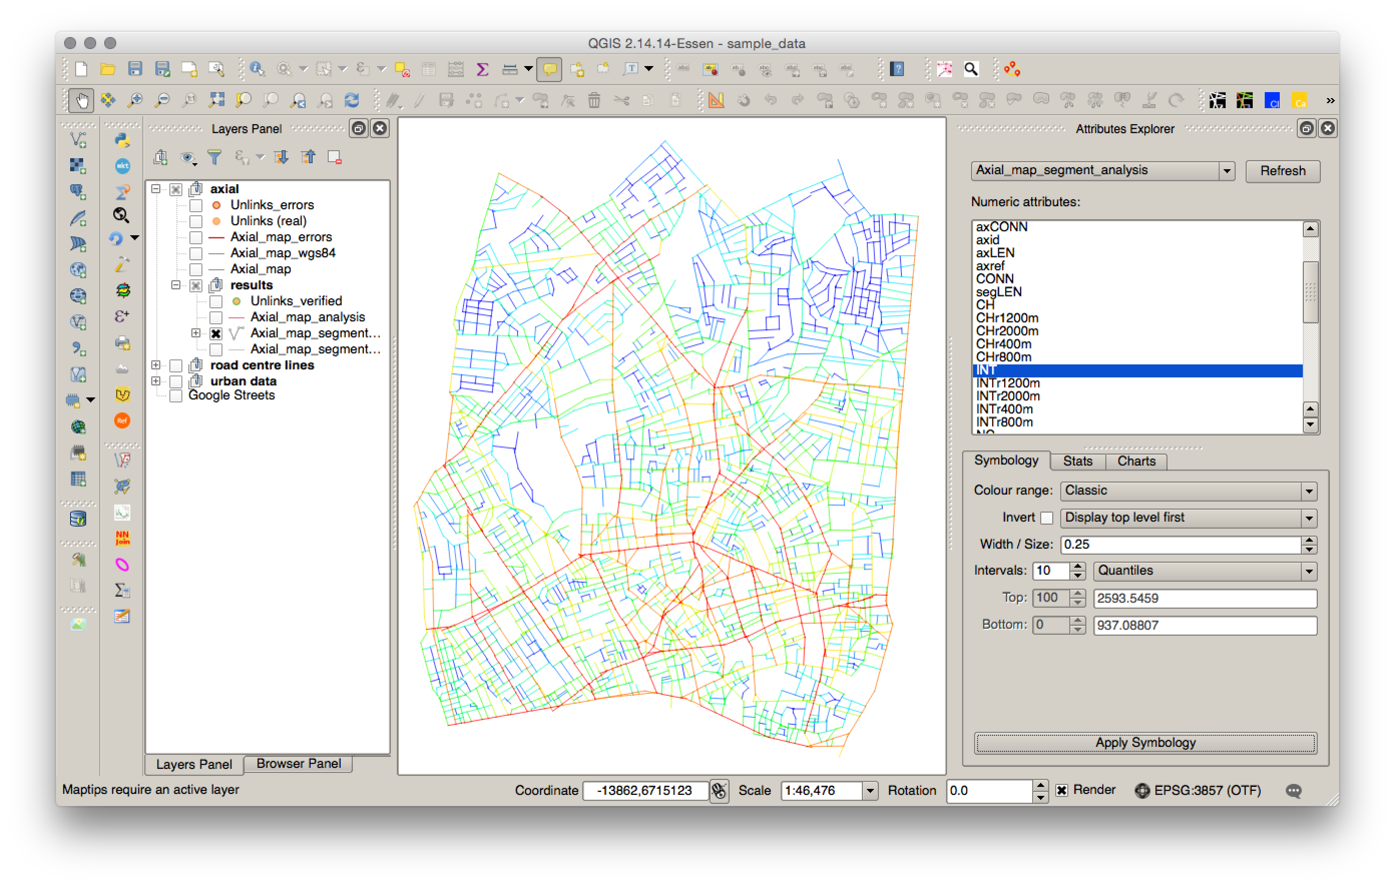
Visualisation and discussion of the results
Changing intervals: 10 quantiles

Slide 33
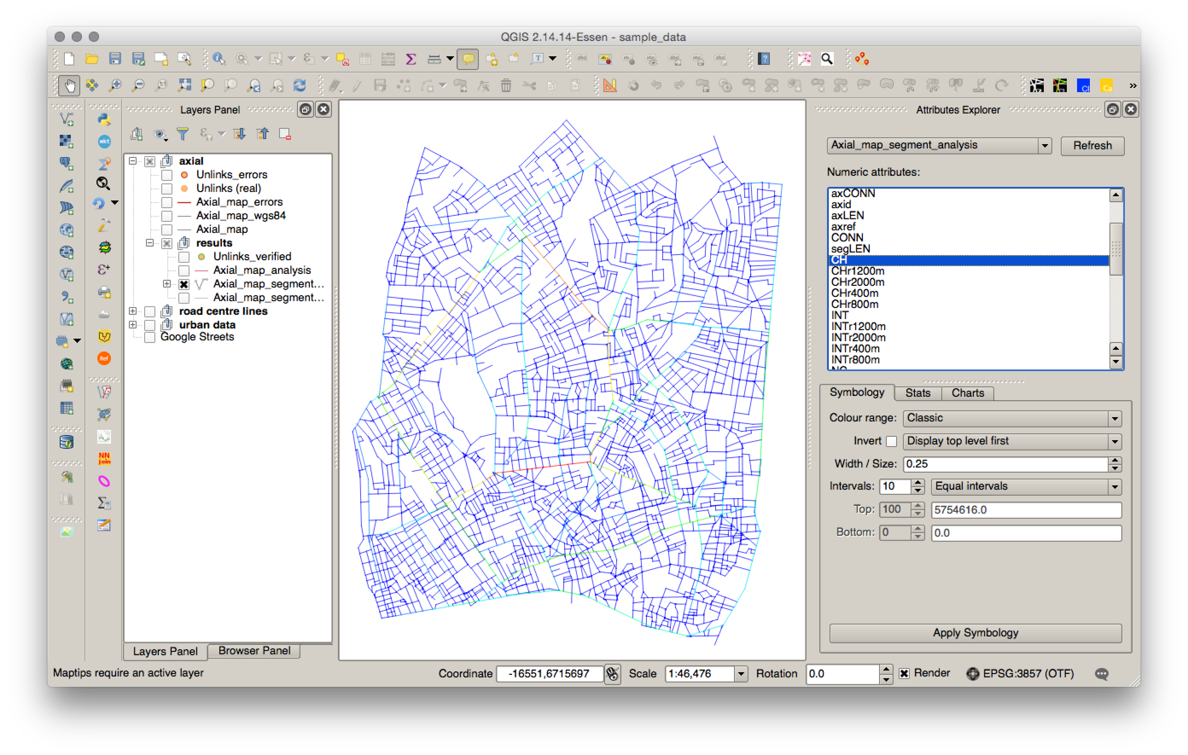
Visualisation and discussion of the results
Changing intervals: equal ranges with Choice

Slide 34
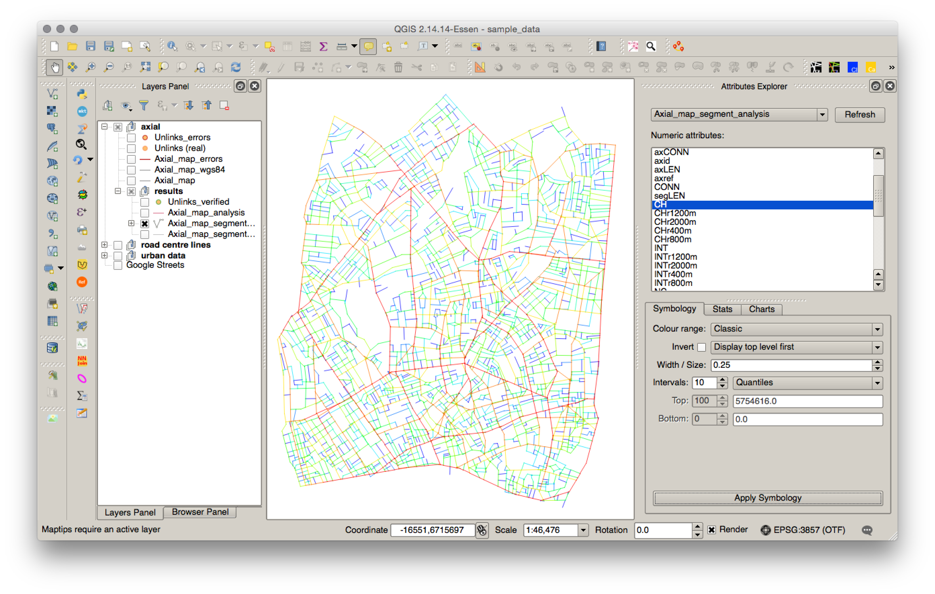
Visualisation and discussion of the results
Changing intervals: 10 quantiles with Choice

Slide 35
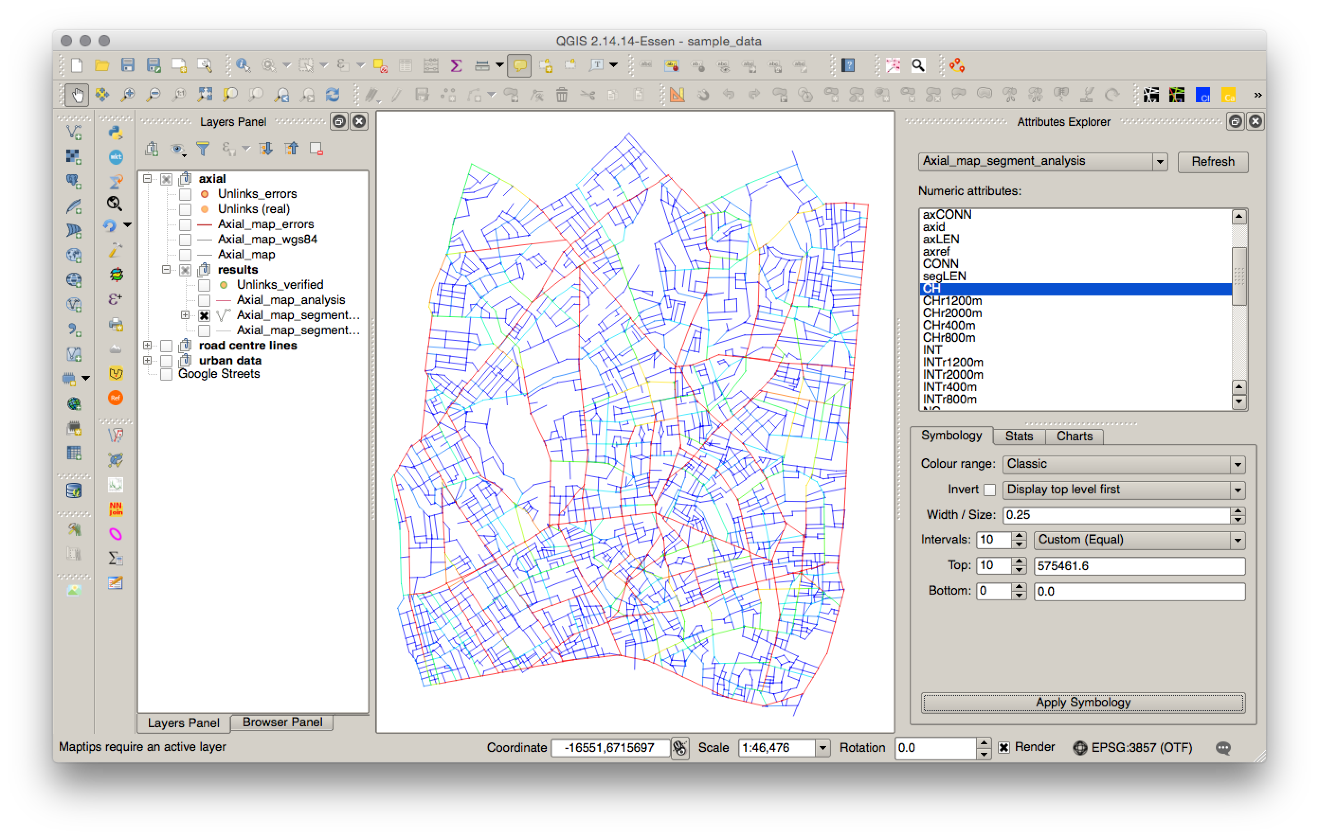
Visualisation and discussion of the results
Changing intervals: custom range with Choice

Slide 36
Normalisation of Space Syntax measures
Normalised angular choice
Normalised choice aims to solve the paradox that segregated designs add more total (and average) choice to the system than integrated ones. It divides total choice by total depth for each segment in the system. This adjusts choice values according to the depth of each segment in the system, since the more segregated is, the more its choice value with be reduced by being divided by a higher total depth number. This would seem to have the effect of measuring choice in a cost-benefit way.
Sources Hillier, B., Yang, T., Turner, A., (2012) Advancing depthmap to advance our understanding of cities. In: Greene, M and Reyes, J and Castro, A, (eds.) 8th International Space Syntax Symposium. Pontificia Universidad Catolica de Chile: Santiago, Chile.
NACH = logCH+1/logTD+3
Normalising least angle choice in Depthmap - and how it opens up new perspectives on the global and local analysis of city space
http://discovery.ucl.ac.uk/1389938/

Slide 37
Normalisation of Space Syntax measures
Normalised angular integration
Normalised angular integration aims to normalise angular total depth by comparing the system to the urban average.
Sources Hillier, B., Yang, T., Turner, A. (2012) Advancing DepthMap to advance our understanding of cities: comparing streets and cities, and streets to cities. In: Greene, M and Reyes, J and Castro, A, (eds.) 8th International Space Syntax Symposium. Pontificia Universidad Catolica de Chile: Santiago, Chile.
NAIN = NC^1.2/TD
Normalising least angle choice in Depthmap - and how it opens up new perspectives on the global and local analysis of city space
http://discovery.ucl.ac.uk/1389938/

Slide 38


Slide 39
Task 2
Preparing other urban data layers
Urban Data Input Tool: recoding frontages, entrances and land use surveys
Creating the data layer
Drawing new features
Updating features
Viewing the attributes

Slide 40
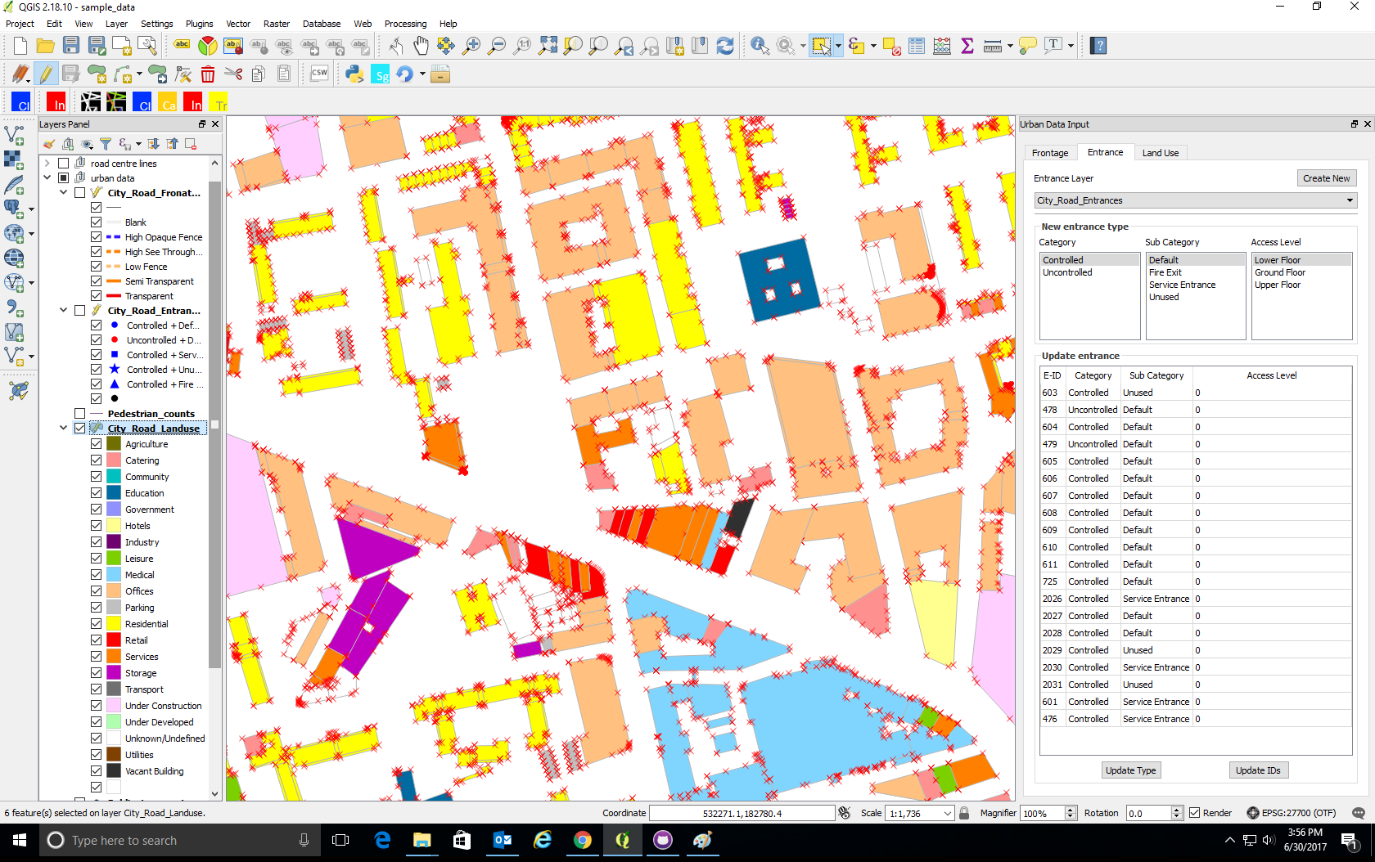
Urban Data Input Tool
Urban Data Input Tool is a plugin to ease aid the input of urban data like frontage type, entrance type and land use type as per Space Syntax Limited standards. The Space Syntax community is the key users for the plugin. The display styles and categories included are as per Space Syntax Limited Standards.

Slide 41
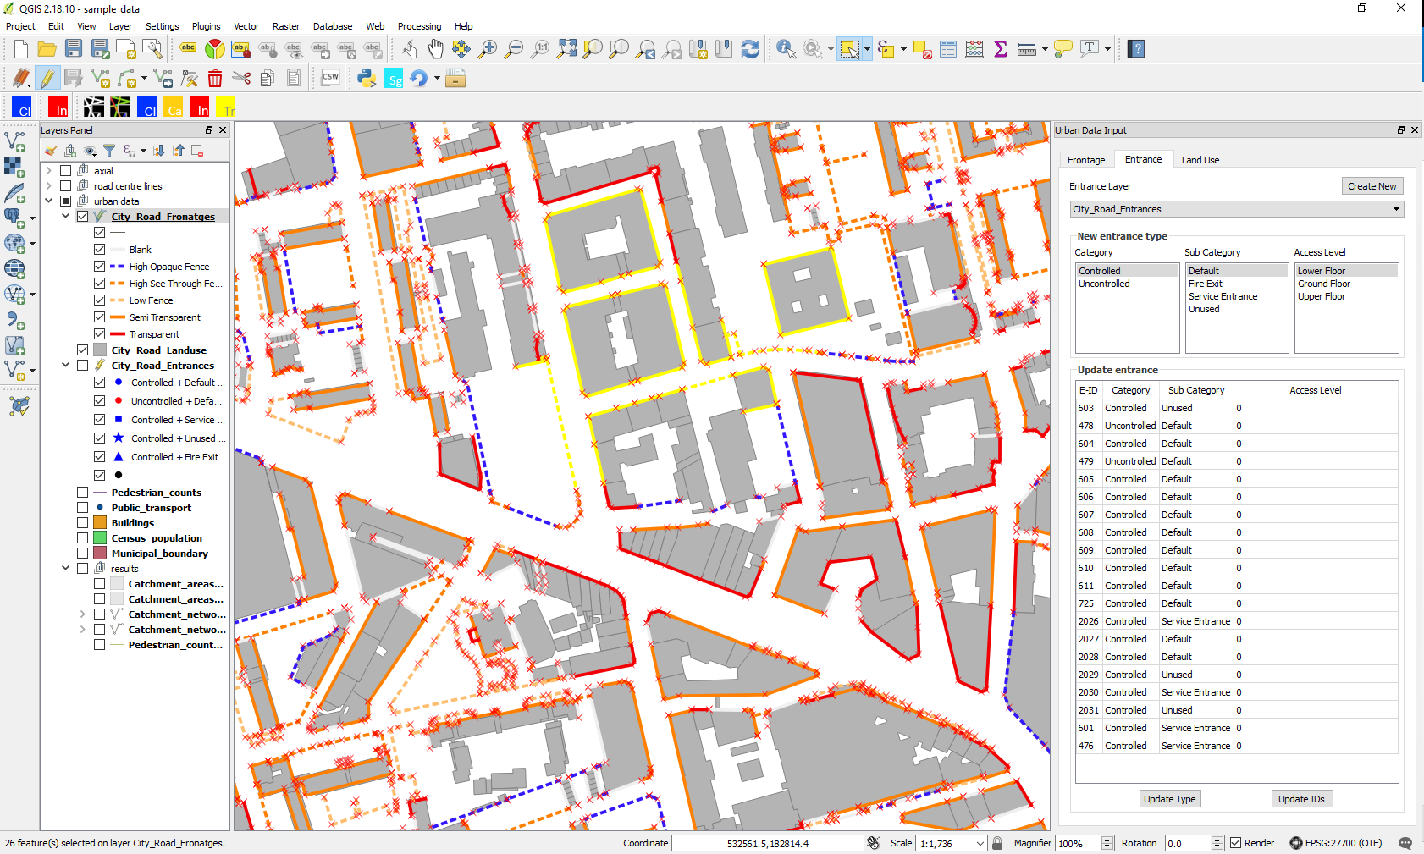
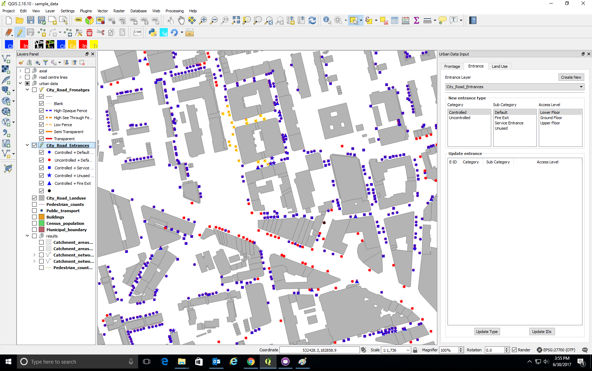
Urban Data Input Tool
Frontage survey
Entrance survey
Land use survey

Slide 42
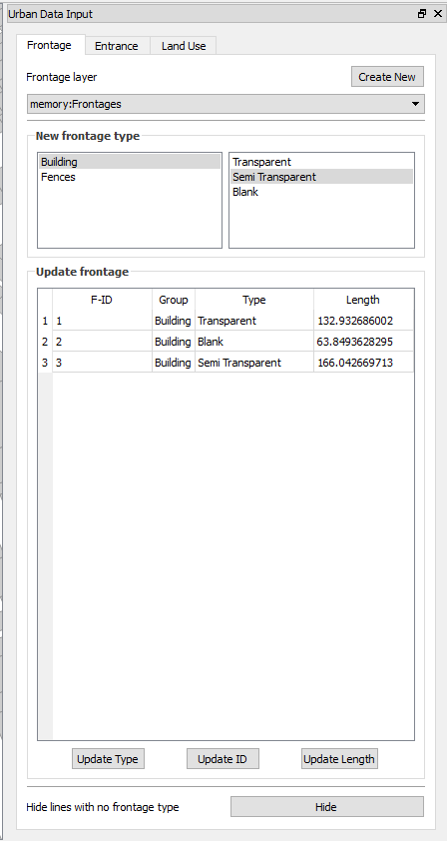
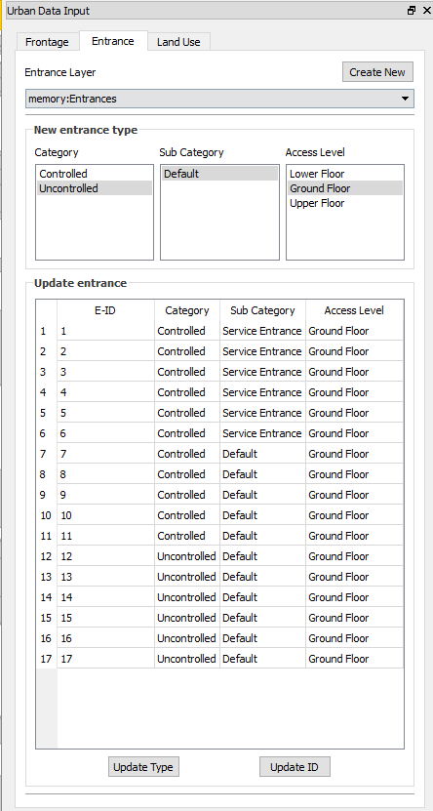
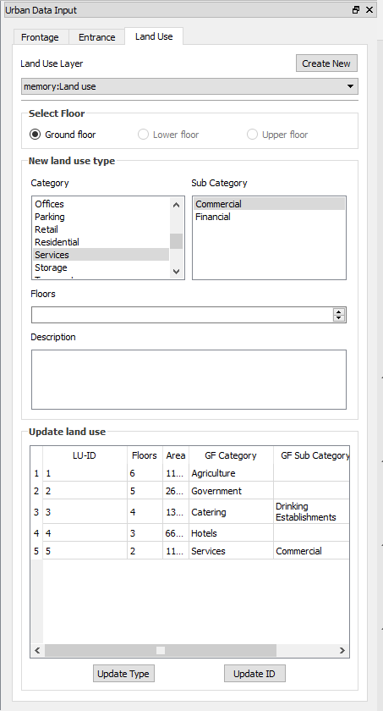
Urban Data Input Tool
Frontage tool
Entrance tool
Land use tool

Slide 43
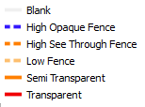
Urban Data Input Tool Frontage tool
Data categories
Create New Frontage layer
Using buildings/block dataset
Without using building/block dataset
Frontage Category
Selected feature data
Update buttons
Hide lines with no data

Slide 44
Urban Data Input Tool Frontage tool

Slide 45
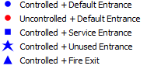
Urban Data Input Tool Entrance tool
Data categories
Create New Entrance layer
Entrance Category
Selected feature data
Update buttons

Slide 46
Urban Data Input Tool Entrance tool

Slide 47
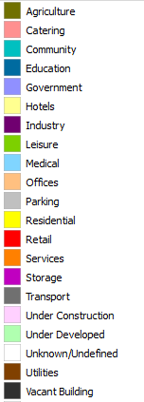
Urban Data Input Tool Land use tool
Data categories
Create New Land use layer
Land use Category
Building data/ description
Selected feature data
Update buttons

Slide 48
Urban Data Input Tool Land use tool

Slide 49
Task 3
Preparing other pedestrian data layers
Creating the data layer
Drawing new features
Updating features
Viewing the attributes

Slide 50
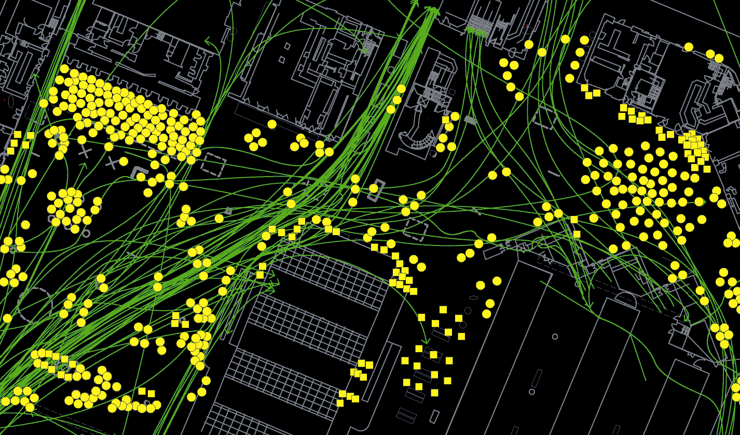
Pedestrian Data Input - Pedestrian traces and snapshots

Slide 51
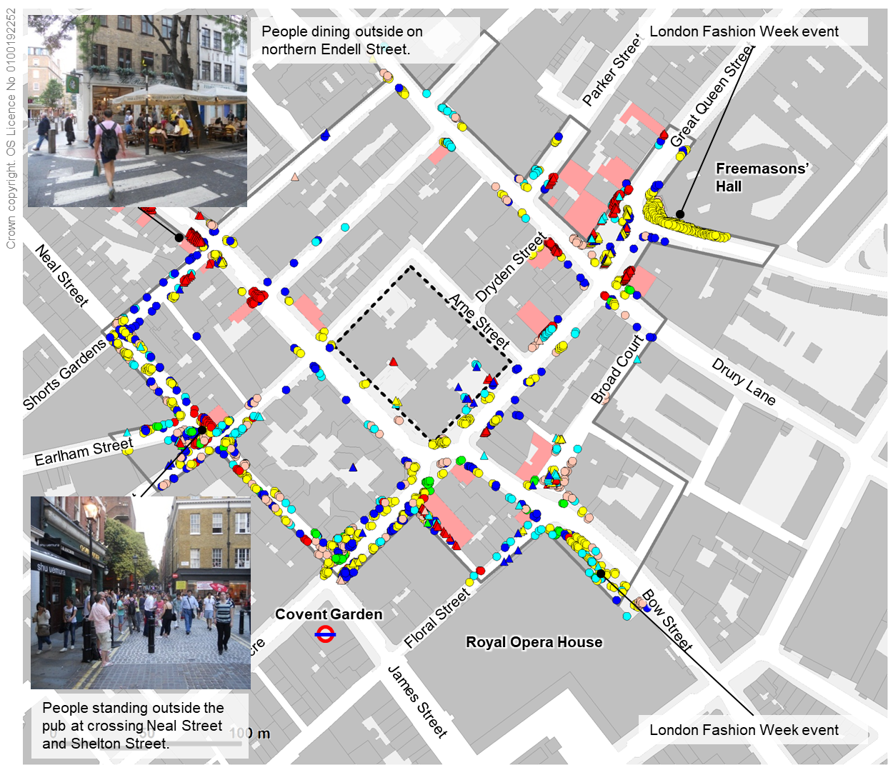
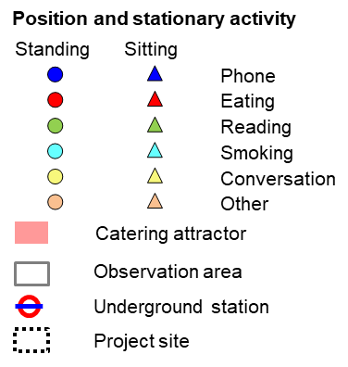
Pedestrian Data Input - Pedestrian snapshots

Slide 52
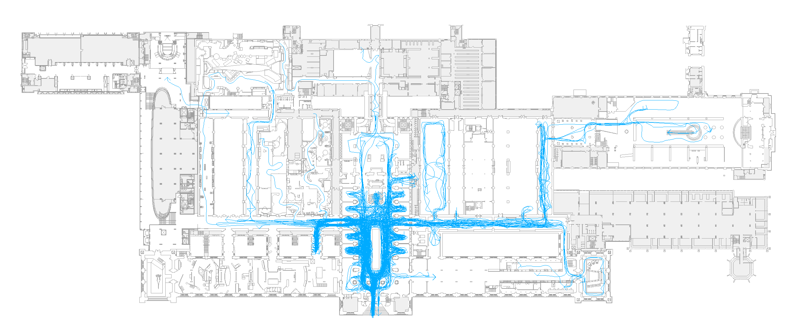
Pedestrian Data Input - Pedestrian traces
Mammals
3%
Waterhouse Gallery
(Temporary)
To upper levels
1%
Darwin Centre
1%
Café
2%
6%
Human Biology
1%
Earth Galleries
3%
Restaurant
Jerwood Gallery
(Temporary)
2%
1%
Creepy Crawlies
2%
Central Hall
7%
Dinosaurs
38%
Shop
2%
Ecology
3%
Ground
Cromwell Road Entrance

Slide 53

SST Github repository
https://github.com/SpaceGroupUCL/qgisSpaceSyntaxToolkit

Slide 54

SST Issues
https://github.com/SpaceGroupUCL/qgisSpaceSyntaxToolkit/issues

Slide 55

SST Wiki
https://github.com/SpaceGroupUCL/qgisSpaceSyntaxToolkit/wiki

Slide 56
Thank you!
SST mailing list:
https://www.jiscmail.ac.uk/cgi-bin/webadmin?A0=SPACESYNTAX-TOOLKIT
Space syntax mailing list:
https://www.jiscmail.ac.uk/cgi-bin/webadmin?A0=SPACESYNTAX

